Slide 1
ALEXA APPLICATION
a multiplatform voice-powered app’s documentation

Slide 2
Technology stack
Alexa skill
Cognito User Pool
CloudFront
API Gateway
Lambda
Application Lambda:
Alexa skill: Handle intents & persist user input
Alexa webpage: receive user request and return queried data for display
Security Lambda:
CloudFront authorizer: Viewer request
Security headers: Origin response
S3:
Front end bucket
DynamoDB:
Alexa user table: partition key = user’s email, sort key = date.

Slide 3










HIGH LEVEL ARCHITECTURE
REQUEST PROCESSING
FRONT-END
DATA STORAGE
AWS SES
WEB APP
Lambda Function
AWS KMS
AWS DynamoDB
PATIENT
API GATEWAY
AWS Alexa
Lambda Function

Slide 4
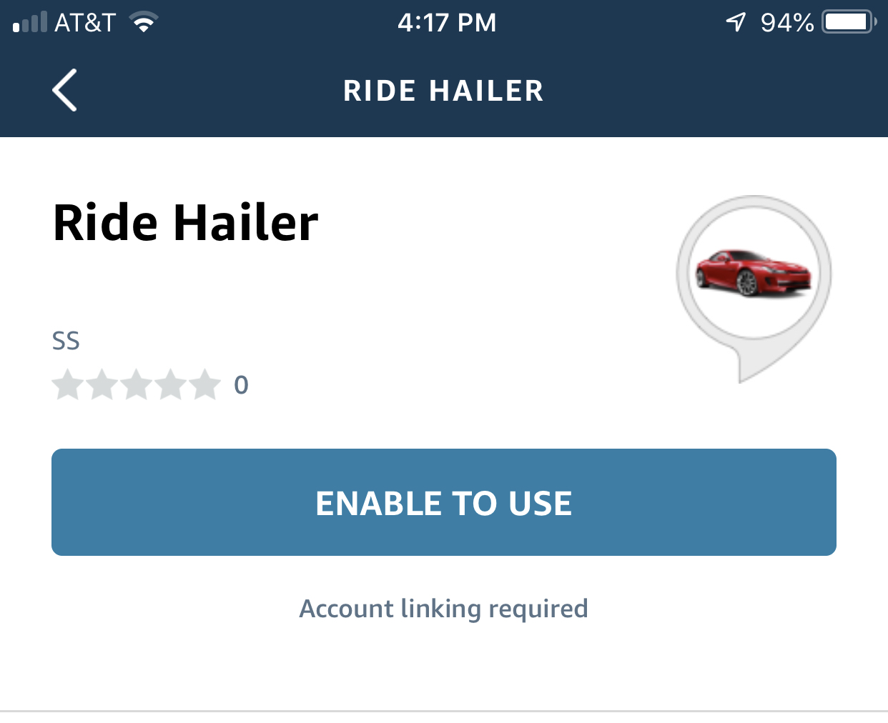
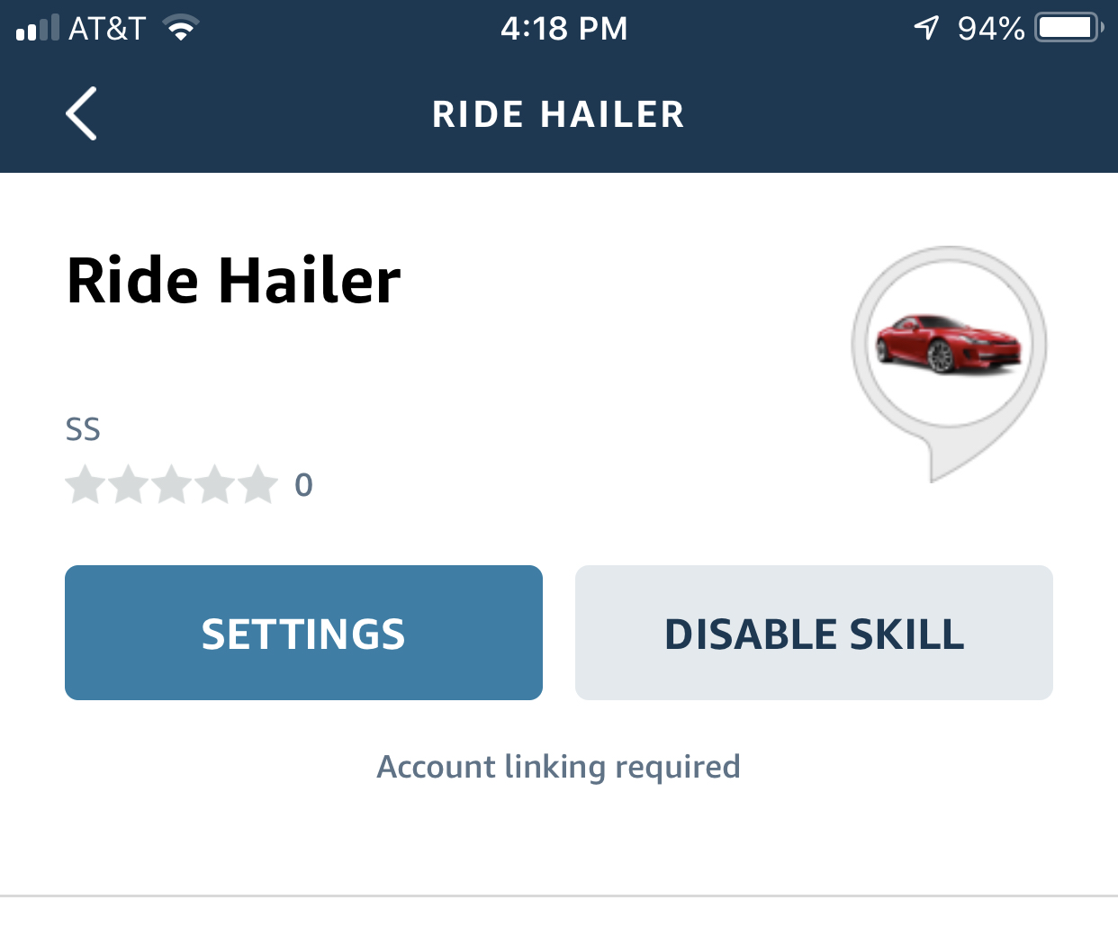
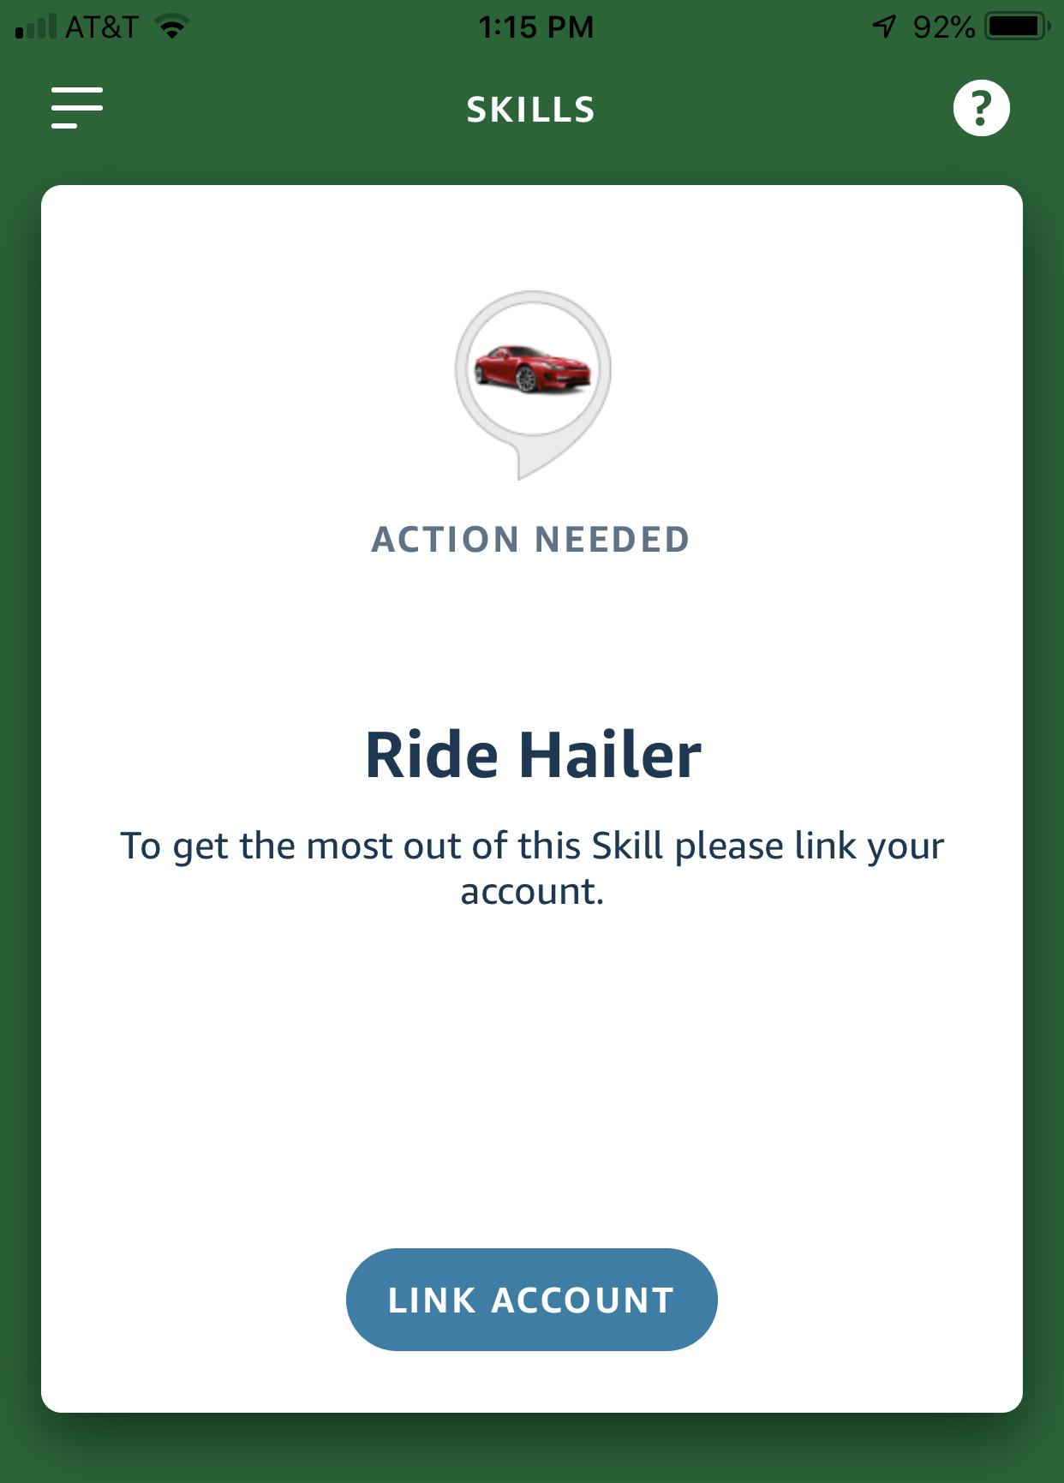
Alexa custom skill Account linking
To connect the identity of the user with a user in another system (i.e., Cognito User Pool or Amazon).
Users can start account linking in one of 2 ways:
2. From a link account card in the Alexa app after making a request that requires authentication.
From the skill detail card in the Alexa app while enabling the skill
Click enable to start linking
Alexa account with another
System acc
Linking is canceled, click
settings to relink

Slide 5




Account linking Authentication FLOW
USER
Alexa app
Alexa Service
Click “Link Account” card
Open URL
Start OAuth
302 Authorization Server
Open redirect URL
Present Login page
Return Login page
Authenticate & Generate Auth code
Enter Cognito Username & Password
Present users’ submitted data
Authorization code & redirect to Alexa service
Exchange Auth code for access token/ refresh token pair
Return Success page in Alexa App
Return Access & Refresh tokens

Slide 6




Authentication architecture
Key​
Unauthenticated Request​
Pre-Token Request​
Authenticated Request​
Successful Response​
Error Response
Origin Response
Error Page
User
Security Headers
Viewer Request
CloudFront Authorizer
Sign in Authentication workflow:
Users go to CloudFront URL, get redirected to Login page
Login info is authenticated by Cognito or 3rd party provider
Cognito returns Auth code to CloudFront Authorizer to exchange for token
Token is validated by Auth Provider and is used for future requests.
Alexa Webpage is sent back with this auth token stored in the cookie.
Request Webpage to cache
Returns Code to CloudFront URL
Check Token
Auth by Cognito User pool or
Login with Amazon
Amazon S3 bucket
Exchanges code for token
Generate and Validate Token
Cognito

Slide 7
cOGNITO CONFIG options
Besides logging in through Cognito or 3rd party Authentication providers, users can have their email domain (e.g., @merck.com) to be validated.
Lambda func: contain the validation code + return a success/error callback
Cognito User pool Trigger: for pre sign-up event.*
Prevent invalid emails with Cognito PreSignUp trigger for validation of email domains.
Validate usernames: prevent user impersonation*
*Reference: https://andreybleme.com/2020-01-18/validate-user-email-domain-aws-cognito/
*Reference: https://aws.amazon.com/blogs/aws/safely-validating-usernames-with-amazon-cognito/

Slide 8


API architecture
Alexa Webpage
Cognito API
Authorizer
API Gateway
API Authorizer controls access to API & other
Resources via Cognito User pool
/Skill_input
/Webpage
Alexa Lambda
Webpage Lambda
Query by datetime
Returns all matched entries for user
Alexa User

Slide 9
User experience
With the benefit of Amazon Cognito, users can sign up via Amazon Cognito (i.e., unauthenticated guests) or public login providers (Amazon, Facebook, and Google). All users have a directory profile accessible via SDK.
Users:
Register/Sign up (Cognito login or Login With Amazon*)
Verification
Login & Authenticate
Click “Report to Alexa” OR Open Alexa App → Browse Skills or say “Open My Reporting skill”*
Report Symptoms and Rating
Query on Date to retrieve corresponding data.
*Create Security profile for LWA: https://developer.amazon.com/docs/login-with-amazon/register-web.html. Then integrate LWA with AWS via Cognito:
https://developer.amazon.com/blogs/appstore/post/57b13855-eb13-4ef9-9d9a-95ba48da4459/login-with-amazon-integrations-amazon-cognito
*Skill name is subject to change

Slide 10


USER-SKILL interaction
USER
Alexa Service
Alexa Skill
Resource server
“Alexa, open My Reporting skill”
Request + access token
Access protected input API w/ token
Responses “Welcome to Reporting skill, what’s your name?” to user
Lambda returns response
“My name is X” or equivalent utterances
Request + access token
Responses “Hi X, how are you feeling and rank it from 1-5?” to user
Lambda returns response
“2 for headache”
Request + access token
Responses “Sorry to hear that, I logged 2 for headache” to user
Lambda returns response

Slide 11
Development phases
Development: Skill in dev is available to developer + beta testers with devices registered to the dev account
Sanity testing:
Beta testing:
Certifying the skill:
Publishing the skill:

Slide 12

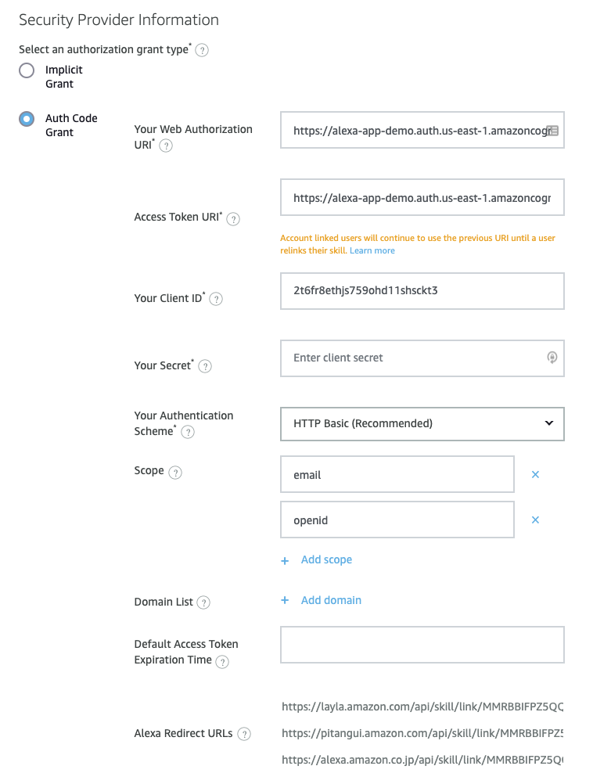
Alexa Dev console Linking config
Info coming from Account Linking Service (i.e., Login with Amazon)
Web Auth URI: URL that Alexa Service sends users for authentication.*
Cognito Login Page: /login
Login With Amazon page: https://www.amazon.com/ap/oa
Access Token URI: URI for the access token endpoint for the authorization server (exchange auth code for an access token here).
Client ID: Cognito User Pool’s App Client ID (i.e., Alexa Webpage)
Secret: Cognito User Pool’s App Client’s secret
Alexa Redirect URLs: Login page must redirect authenticated user is to these Amazon-provided endpoints (is passed to login page as redirect_uri parameter in authorization URI).
* Authorization URI redirects the user to the redirect_uri and includes state and code in the URL query string.

Slide 13
Future additional features
Enable doctors/medical professionals to access patients’ reports
Add Cognito Identity pool to grant diff credentials than patients’ creds

Slide 14
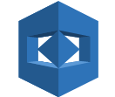


hIGH-lEVEL ARCHITECTURE
AWS Rekognition
Rekognition DynamoDB
Relationship DynamoDB
Clean DynamoDB
S3 Bucket
2
Step Function
Rekognition Lambda
ML Model
Metadata Parsing Lambda
Download Parsing Lambda
Extraction Trigger Lambda
1
Step Function
Textract Lambda
Textract S3 Bucket
3
RAW DynamoDB
AWS Textract
14

